Slide 1
EDC2019 - Expose

Slide 2
Application Programming Interface (API)
What is it?
Why do we use it?
Notes:
- What is it?
- Architectural design to abstract away the specific implementation of certain parts
- Why do we use it?
Decoupling logic, making the solution more flexible.
Increases re-usability of components

Slide 3
Representational State Transfer (REST)
Client-Server Architecture
Statelessness
Cacheability
Layered System
Uniform Interface:
Resource Identification in Requests
Resource Manipulation through representations
Self-descriptive messages
Hypermedia as the engine of application state
Notes:
- Client-Server Architecture
Separation of concerns. Separating the user interface from the data storage
Improves portability and scalability
Allow for independent evolvement of the components
- Statelessness:
- No client context is stored on the server between requests. Each request from any client contains enough info to process the request.
- Cacheability:
Responses must implicitly or explicitly define themselves as cacheable, to prevent stale data reaching the client.
Important to do properly, to increase scalability and performance.
- Layered System
A client should not have to care what server it is talking to
Enables load balancing, shared caches, added security layers etc.
Distribute a client call to many backends
Uniform Interface:
- Resource identification in request:
Individual resources are identified in requests, example using URIs.
Resources are conceptually separate from their representation, i.e can return HTML, XML, or JSON.
- Resource manipulation through representation:
When a client holds a representation of a resource, including any attached metadata,
It as enough information to modify or delete the resource
- Self-descriptive messages
Each message include enough information to describe how to process the message
Example, which parser to invoke specified by a media type
- Hypermedia as the engine for application state(HATEOAS)
Having accessed an initial URI for the REST application,
A REST client should be able to use server-provided links dynamically to discover all available actions and resources needed.

Slide 4
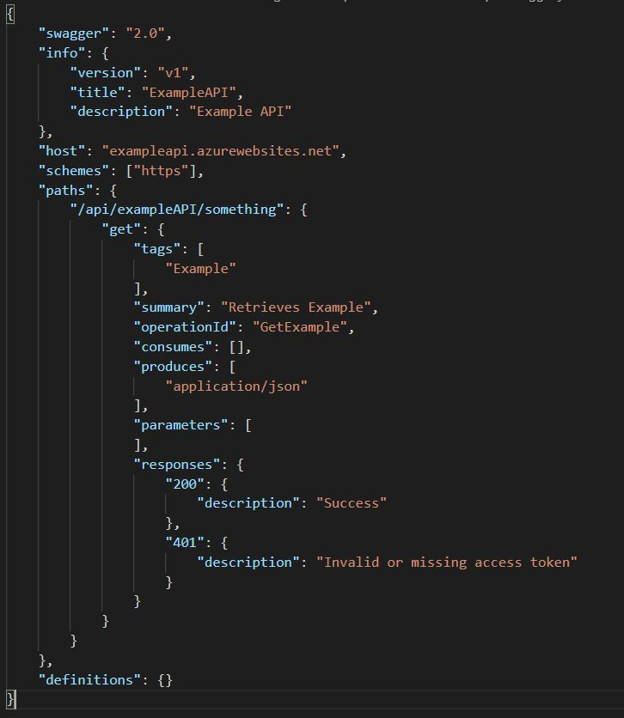
Open API Specification
OAS2.0: Swagger
JSON or YAML
Info
Host & schemes
Paths
Parameters
Responses
Input and output models
Authentication
Notes:
V2: Swagger
Started as a open-source software framework
Has a large collection of tools that help developers design, build, document and consume RESTful web services.
JSON or YAML
Info
Host & schemes
Paths
Parameters
Responses
Input and output models
Authentication

Slide 5
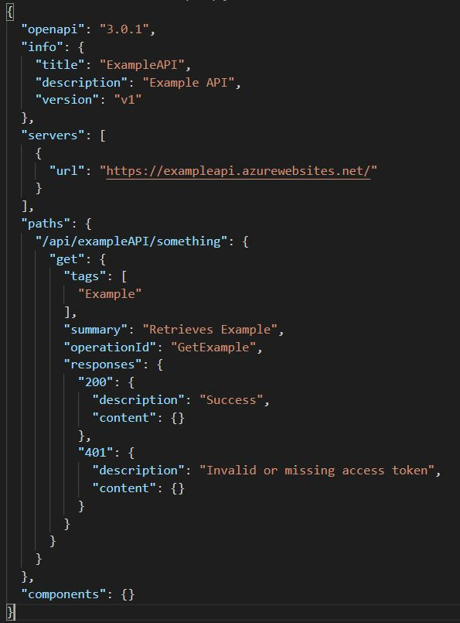
Open API Specification
OAS3.0:
Simplified structure
Content negotiation
Form data can now contain objects and arrays
Enhanced security definitions
Updated Parameter types
Improved Examples
Support for describing callbacks
Notes:
V3:
Simplified structure
Content negotiation
Form data can now contain objects and arrays
Enhanced security definitions
Updated Parameter types
Improved Examples
Support for describing callbacks

Slide 6
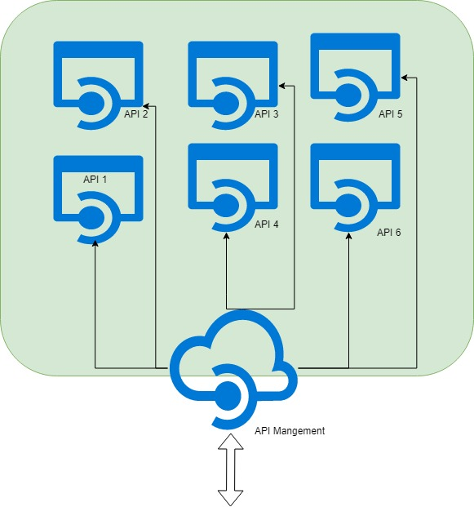
Azure API Management
Two main components:
Gateway
Developer Portal
Notes:
Gateway
Can perform certain tasks on requests
Forwards the request to the appropriate backend
Developer Portal
Discover APIs
Read documentation and test APIs
Publish your own APIs for other to discover

Slide 7
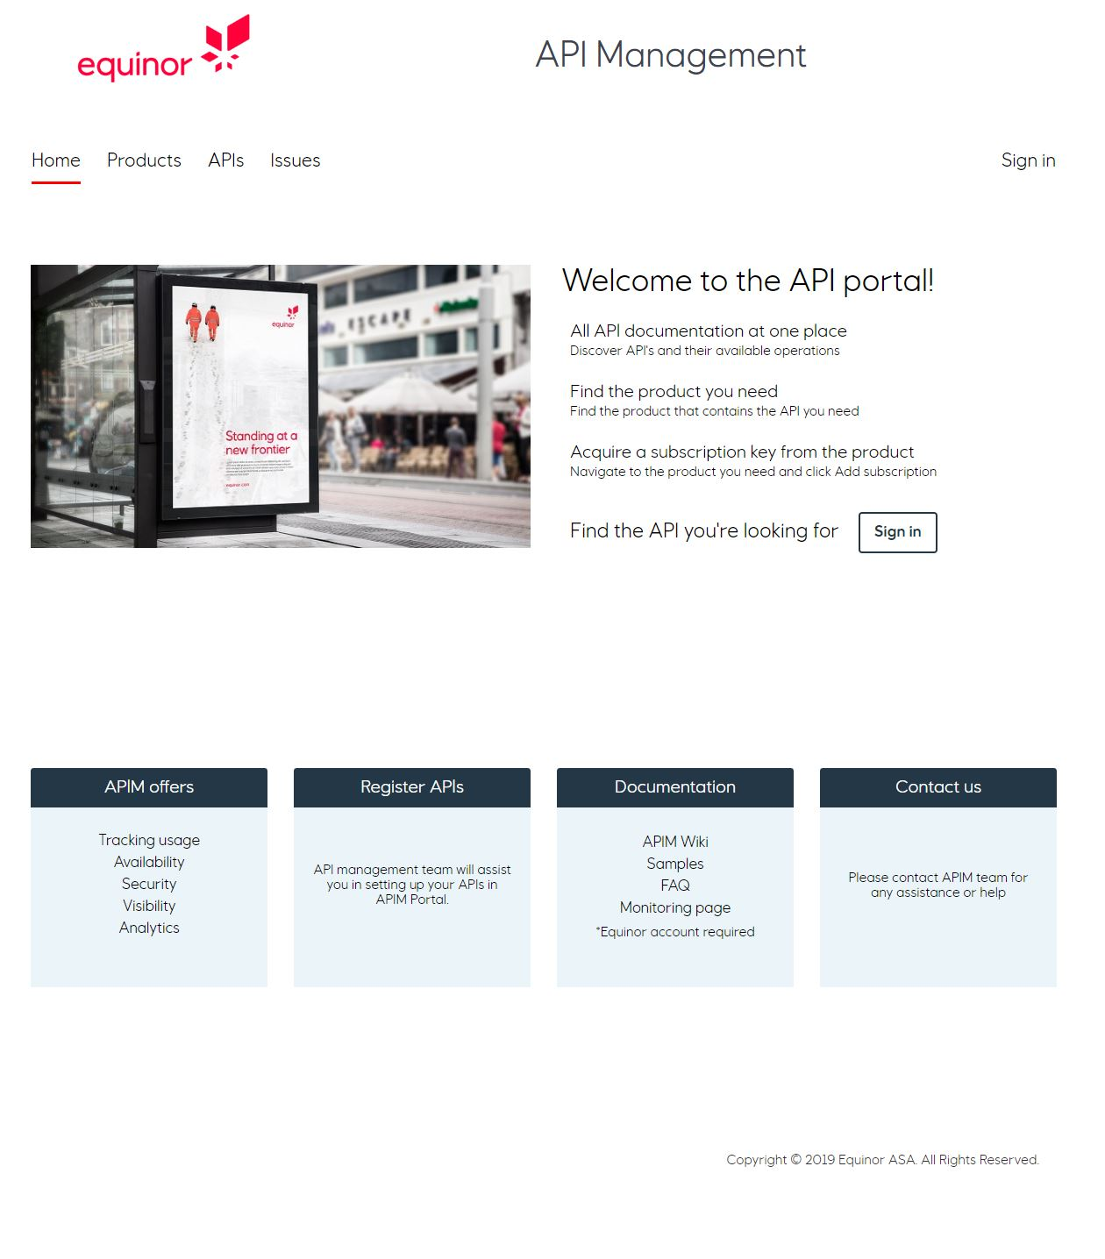
Azure API Management

Slide 8
Exercise: Expose
Part 1:
Use the provided skeleton code and implement the API
Part 2:
Implement the Aggregates controller

